Slide 1
Deep Learning for Emotion Recognition in Cartoons
Shubham Kumar (00815007721)
Abhishek Sharma (00115007721)
Arjun Sharma (00415007721)
Under the guidance of
Ms. Preeti Sehrawat
Assistant Professor

Slide 2
Aim
Measure how accurate the program is able to identify an emotion from a given cartoon video.

Slide 3
Requirements

Slide 4

— Choose a cartoon: Choice was Tom & Jerry².
— Lots of various emotions in each episode.
Segment faces from the cartoon.
Build a dataset of emotions for each main character (Tom & Jerry)
Train the network on a labeled dataset.
2
Tom & Jerry © Warner Bros. Entertainment, Inc

Slide 5
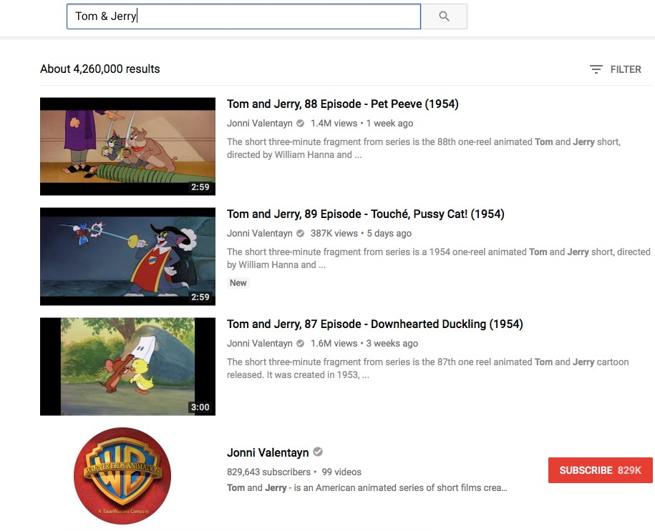
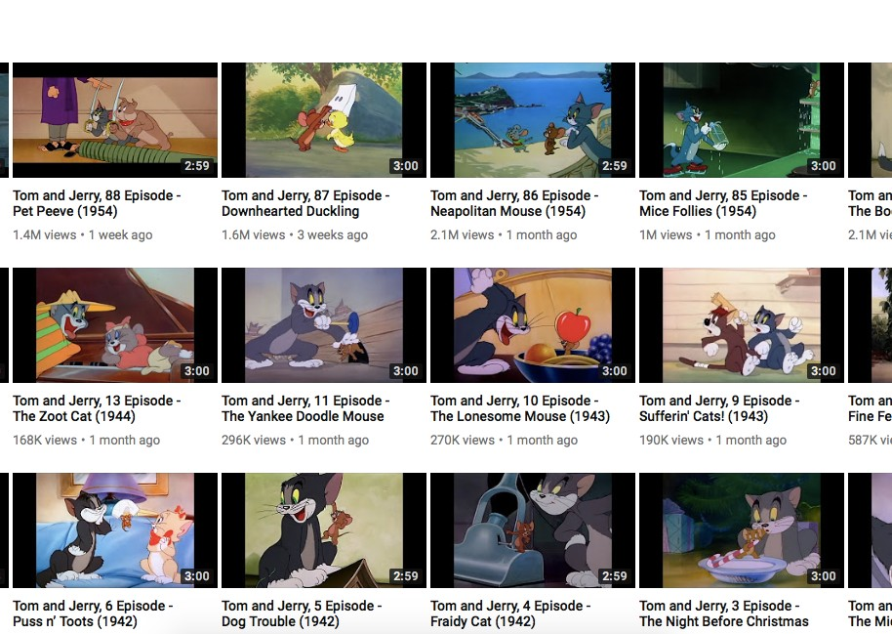
Dataset Gathering

Slide 6
Segmentation

Slide 7
Haar Cascades

Slide 8
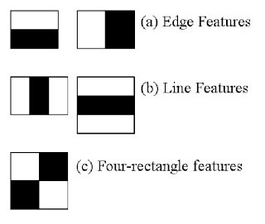
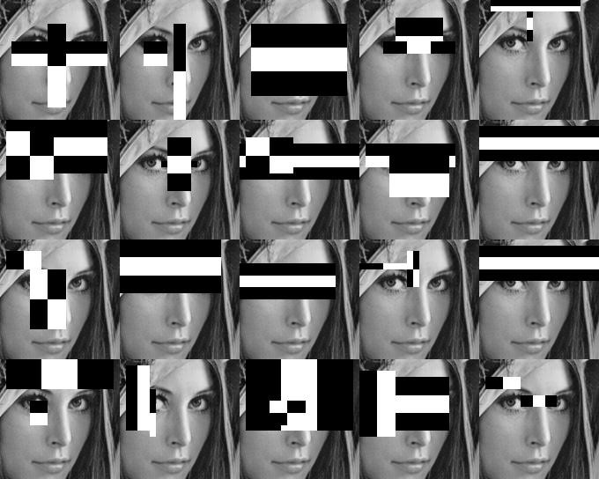
Haar Cascades

Slide 9
— Created custom Haar cascade for both Tom & Jerry.
Haar Cascades
There were none made online to detect cartoon faces, only human ones.
Depending on the window size it does detect other character faces in the cartoon.

Slide 10
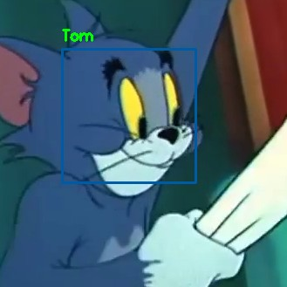
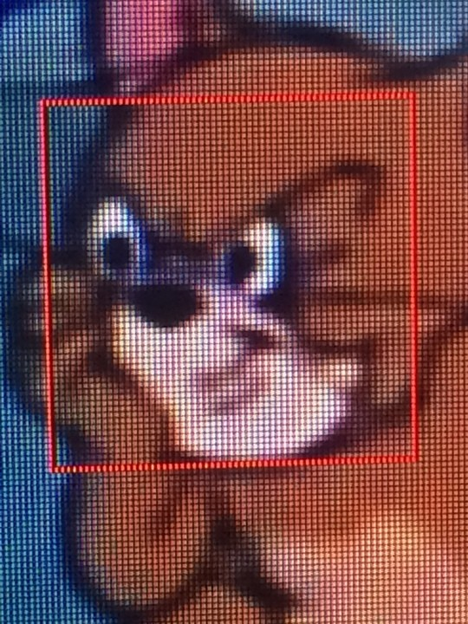
2
Tom & Jerry © Warner Bros. Entertainment, Inc

Slide 11
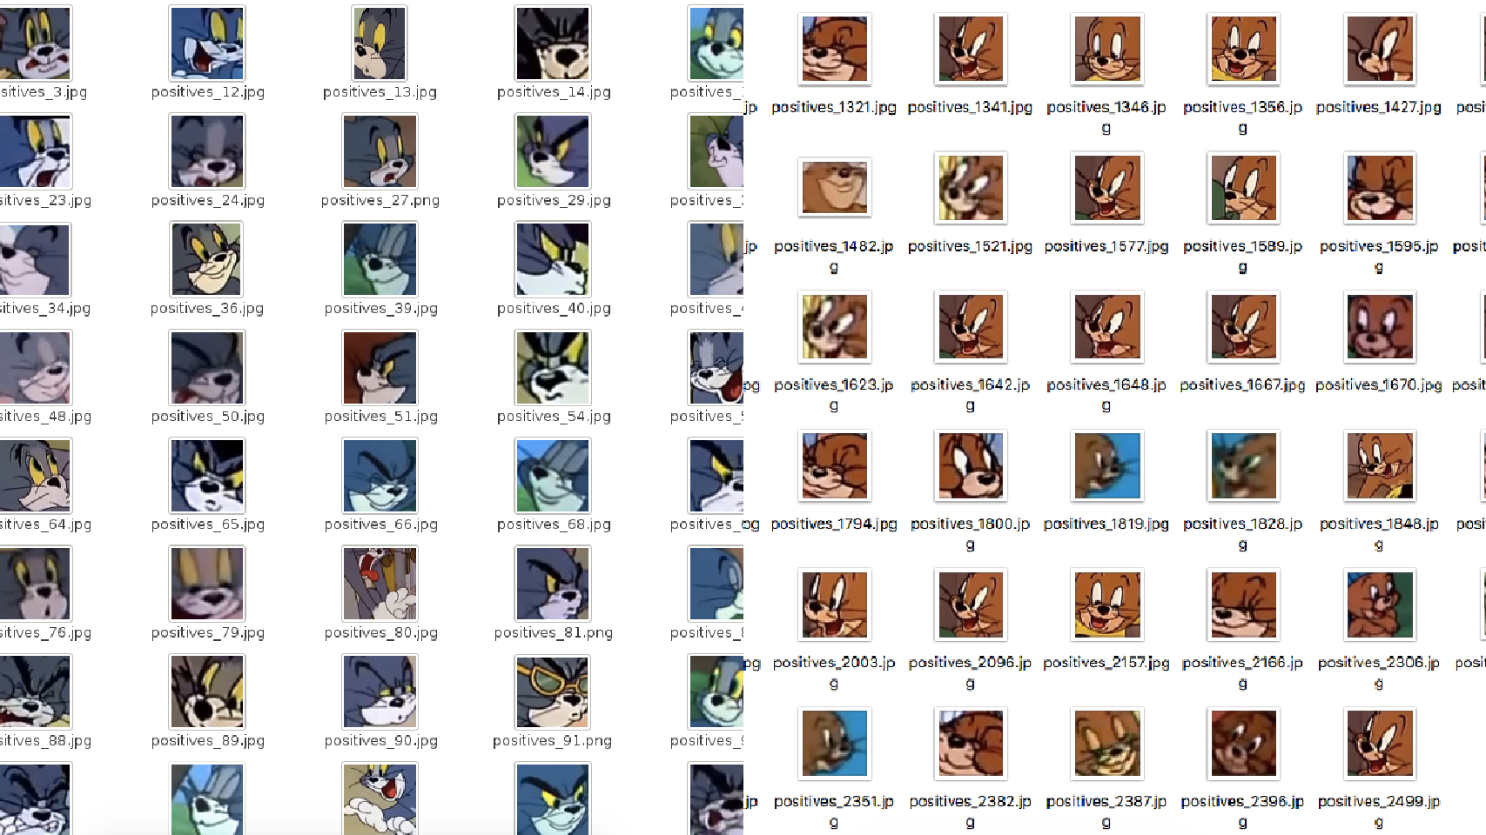
2
Tom & Jerry © Warner Bros. Entertainment, Inc

Slide 12
Dataset Stats

Slide 13
— In total about 159,035 images segmented.
Dataset Stats
— For about ~64 episodes. (Tom & Jerry has over 100)
— Selected around 400 images for each character & emotion, (angry, happy, surprise) for training and testing.

Slide 14
Convolutional Nerual Network

Slide 15
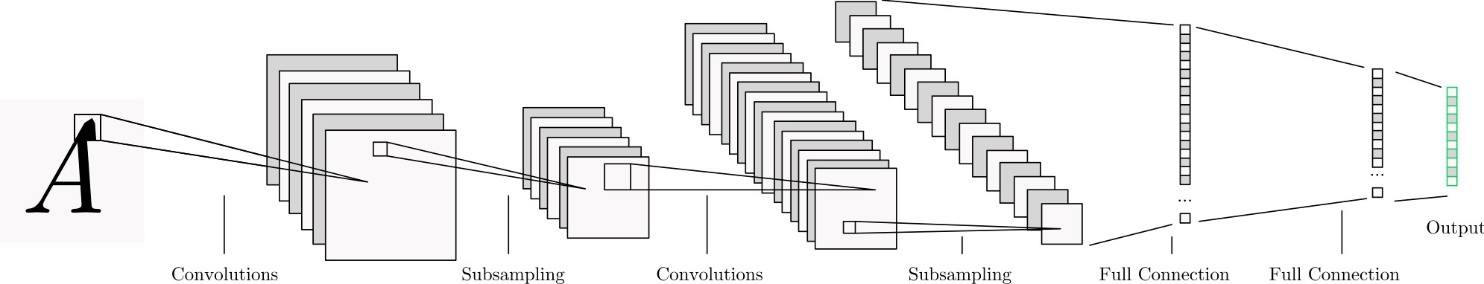

Slide 16
— In recent years CNN's produced great results in image & object recognition.
Convolutional Nerual Network
The CNN is used for this project to learn
features (eg. smile angles, eyebrows).
Framework for DL used was Keras + TensorFlow backend. (Keras also works with Theano)

Slide 17
— No pre-trained network.
Convolutional Nerual Network
— Inception-V3 predicts Tom & Jerry as 'comic books'.
Images resized to 60x60 with 3 channels. (RGB)
3x3 convolution & 2x2 max pooling with a input image of size 60x60x3.

Slide 18
— 3x3 Convolution & 2x2 Max Pooling. (ReLU activation)
Convolutional Nerual Network
3x3 Convolution & 9x9 Max Pooling. (ReLU activation)
Fully connected layer of 512 neruons.
Final output layer of 6 neruons for each emotion.

Slide 19
Algorithm used

Slide 20
The optimization algorithms that are tested and evaluated in the artefact are the following: ▪ Stochastic Gradient Descent (SGD) ▪ Adagrad ▪ Adadelta ▪ RMSprop ▪ Adam
Algorithm Used

Slide 21
Results

Slide 22
— Split dataset into 80% training, 20% testing.
Results
Trained network for 50 epochs on one GPU (Nvidia).
Tested 5 optimisers for 5 runs:
— Adadelta, Adagrad, Adam, RMSprop & Stochastic Gradient Descent (SGD)
Hyperparameters (Layer size, Max pooling size...)

Slide 23
— The network removes around 20-50% of neurons from the network when training. (Dropout)
Results
— Prevents overfitting the network.
Rmsprop overfits the network.
Adadgrad tends to underfit the network slightly.

Slide 24
— Adadelta & SGD optimiser works well with slight overfitting.
Results
— Adam has comparable performance to SGD but underfits in some test runs.
— Adadelta was the best, but SGD was better for
3 test runs. (Both achieved ~80% accuracy)

Slide 25
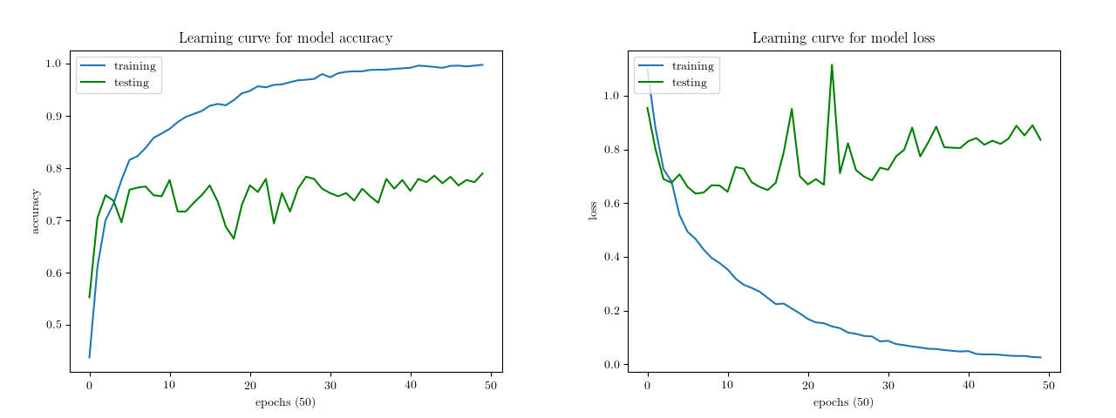

Slide 26
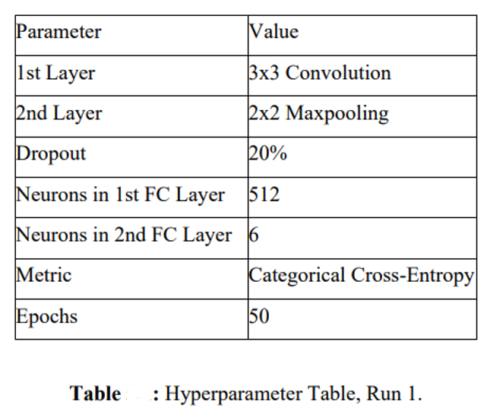
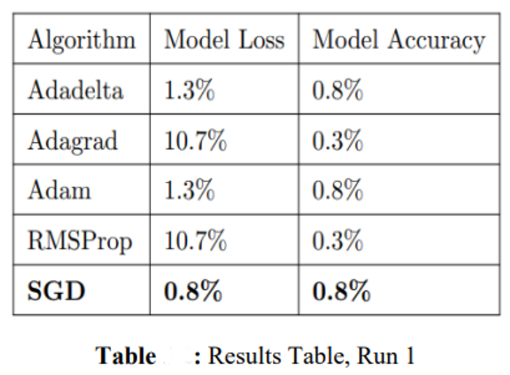
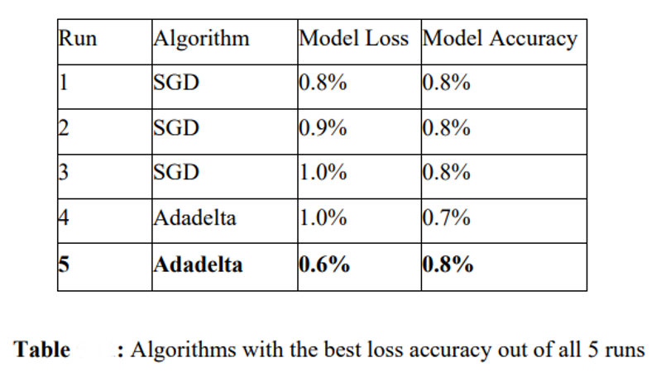

Slide 27
~80% Model Accuracy
~90% Model Loss

Slide 28
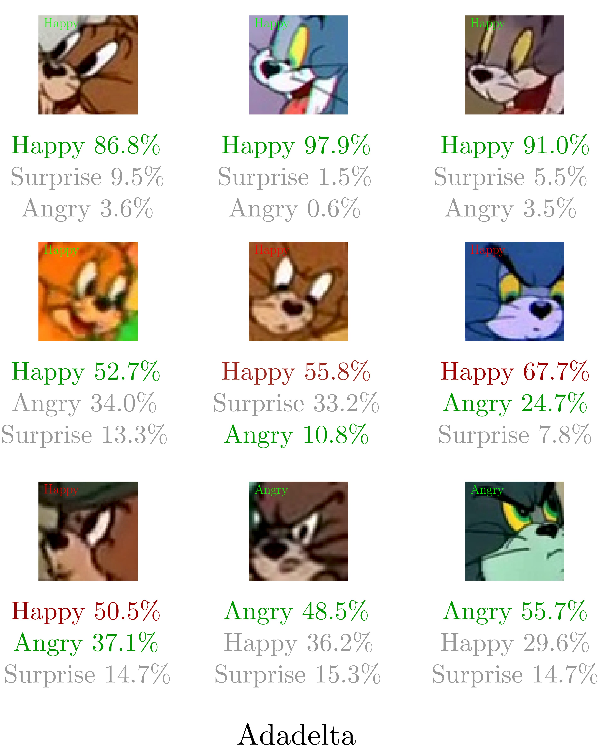
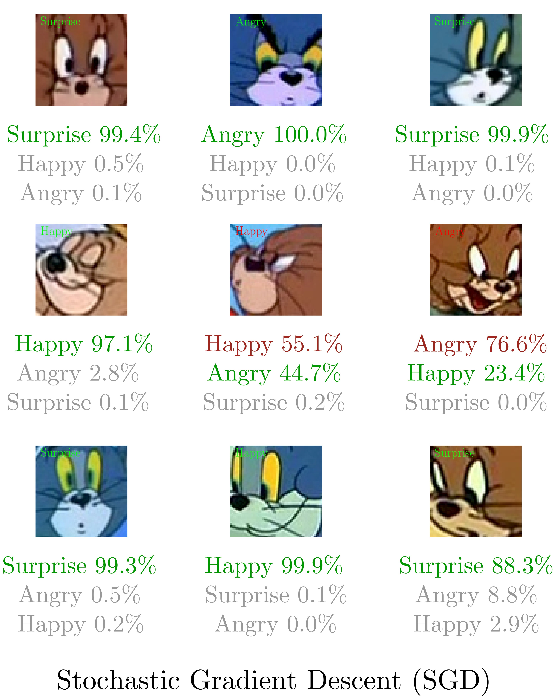
Classification Results

Slide 29
— Animators
Potential Applications
Automatic reference dataset.
Drawing -> Results of cartoons with similar emotions.
Automatic subtitles.
Recommendation Systems (Movies: which character is the happiest?)

Slide 30
References
References
Abadi, M. et al. (2016) TensorFlow - A system for large-scale machine learning. In: CoRR cs.DC
Bishop, C.M. (1995) Neural Networks for Pattern Recognition. New York, NY, USA: Oxford University Press, Inc. isbn: 0198538642.
Gajarla, V. and Gupta, A. (n.d) Emotion Detection and Sentiment Analysis of Images. In: cc.gatech.edu.

Slide 31
Thankyou

